Slide 1
Fusion Grid
Ganji Naveen
MD.Thanveer

Slide 2

About this App
The game starts with two tiles, each displaying either "2" or "4," randomly placed on the 4x4 grid. Players can swipe in four directions: up, down, left, or right. All tiles on the grid will move in the chosen direction until they hit the edge or another tile. When two tiles with the same number collide while swiping, they merge into a new tile with a value equal to the sum of the original tiles. For instance, merging two "2" tiles creates a "4" tile, and combining two "4" tiles results in an "8" tile, and so on. After every successful swipe, a new tile (either "2" or "4") appears on the grid at an empty spot. The game ends when the grid is full, and there are no more possible moves, i.e., no empty spots and no adjacent tiles with matching numbers. The player's goal is to combine tiles and achieve the "2048" tile. However, players can continue playing even after reaching 2048 to achieve higher numbers and aim for a higher score.

Slide 3
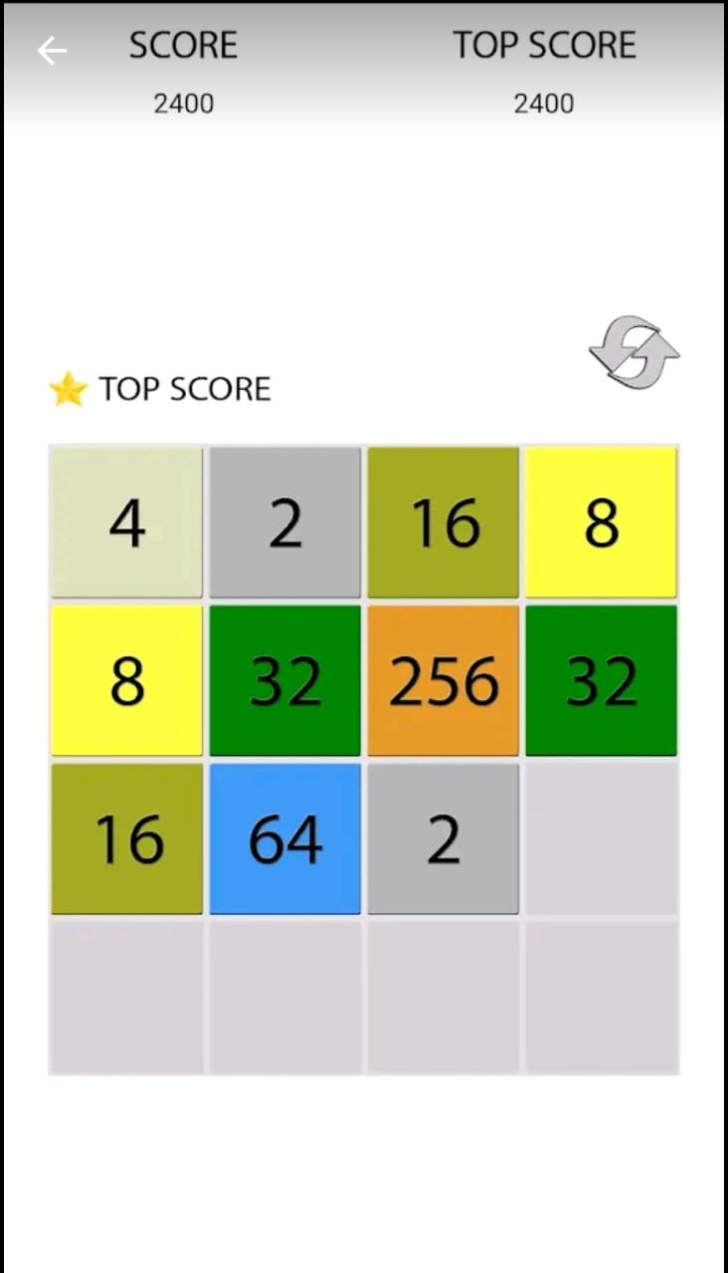
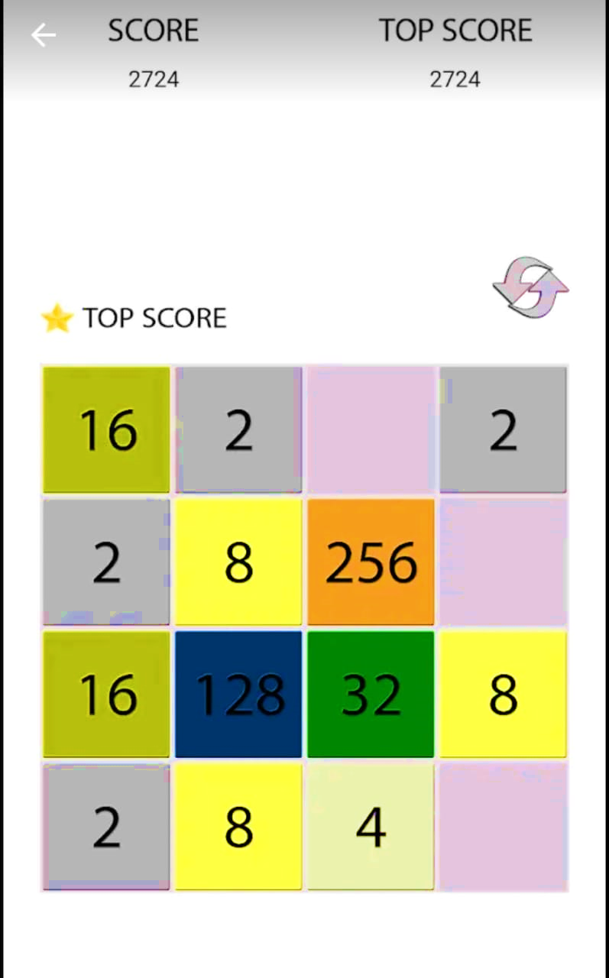
App Interface and Design

Slide 4
Advantages Of Fusion Grid 2048
Entertainment: The primary purpose of the 2048 game is entertainment. It provides a challenging and addictive puzzle-solving experience, allowing players to pass the time and have fun.
Cognitive Skills: Playing 2048 involves strategic thinking, planning, and decision-making. It can help improve cognitive skills such as problem-solving, spatial reasoning, and pattern recognition.
Relaxation: The game's simple design and mechanics make it suitable for relaxation and stress relief. It offers a casual gaming experience that can be enjoyed during short breaks.
Mobile Gaming: The 2048 game gained popularity as a mobile app, making it accessible to a wide audience. Its simple yet engaging gameplay makes it suitable for quick gaming sessions on smartphones and tablets.
Educational Value: While primarily an entertainment game, some educators and parents may use games like 2048 to promote logical thinking and numerical skills in a playful manner. It can be a fun way for individuals to enhance their math-related abilities.
Open Source and Variations: The game's source code is often open-source, allowing developers to create variations or incorporate the game's mechanics into other projects. This has led to numerous versions and adaptations of the original 2048 game.

Slide 5
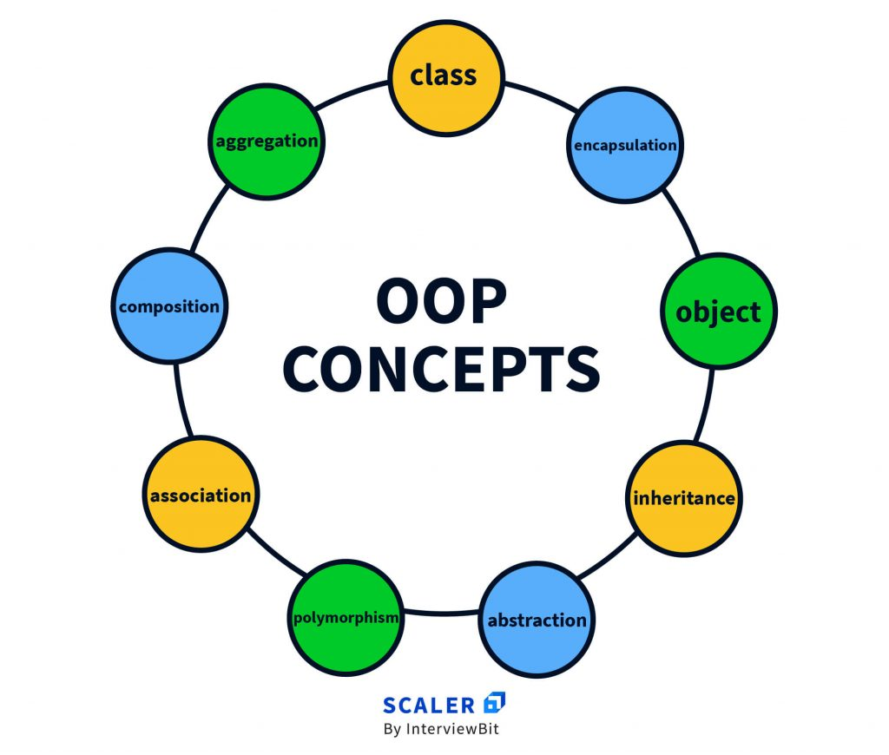

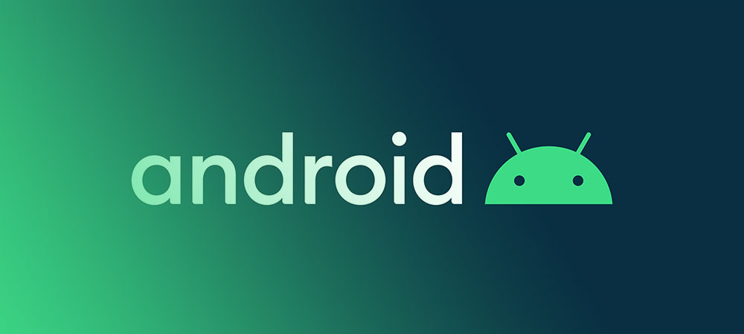
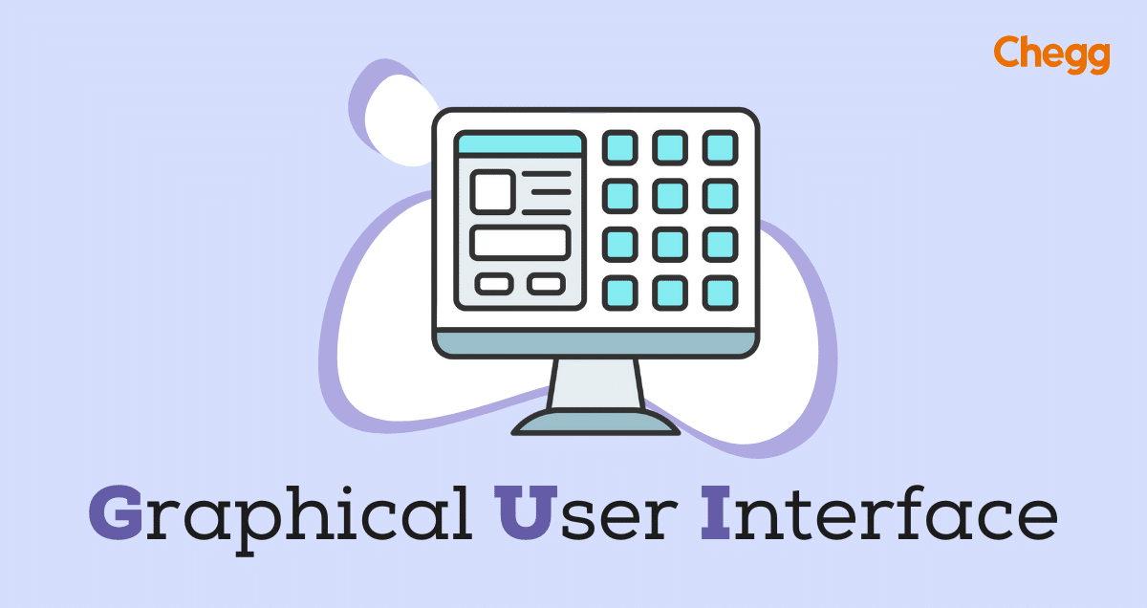
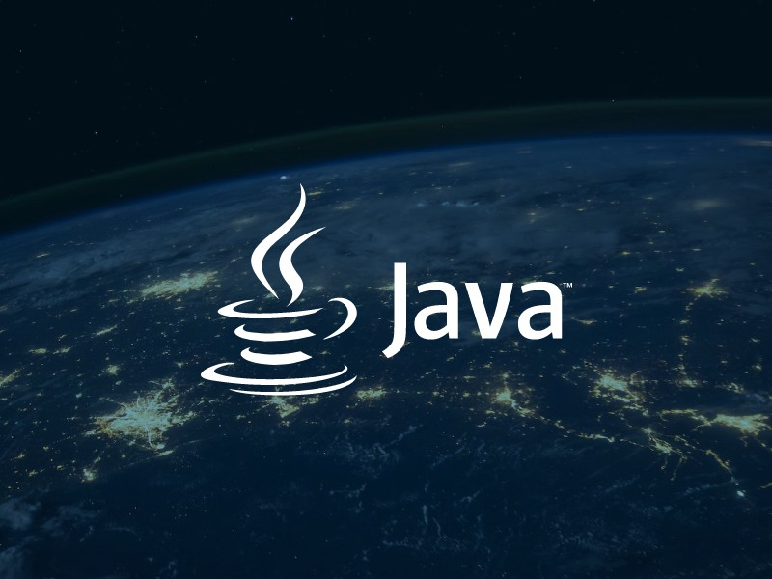
Technologies Used and Platform

Slide 6

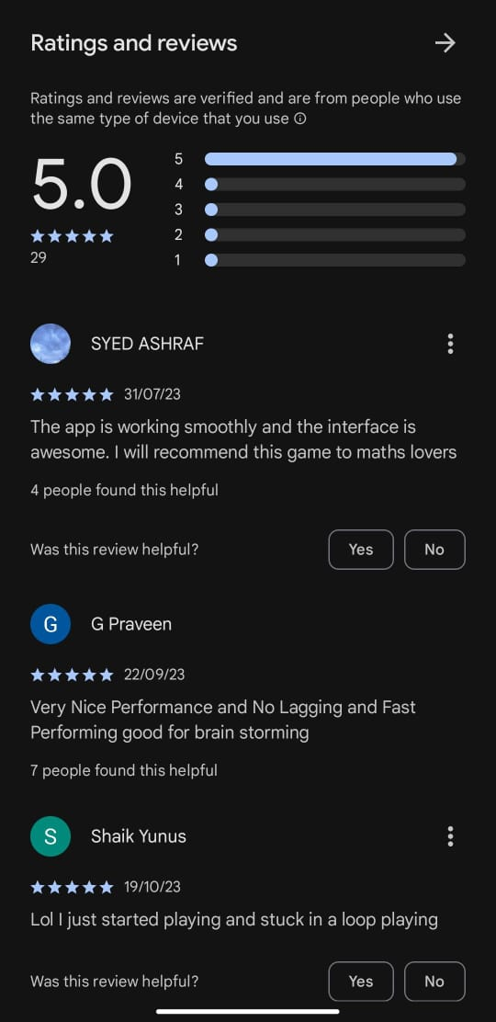
1
Reviews and Downloads
100+Downloads

Slide 7
Ensure to Keep Undo In the Game To Get Back To Previous Puzzle
“
Future Updates
”

Slide 8

Fusion Grid 2048

